Slide 1
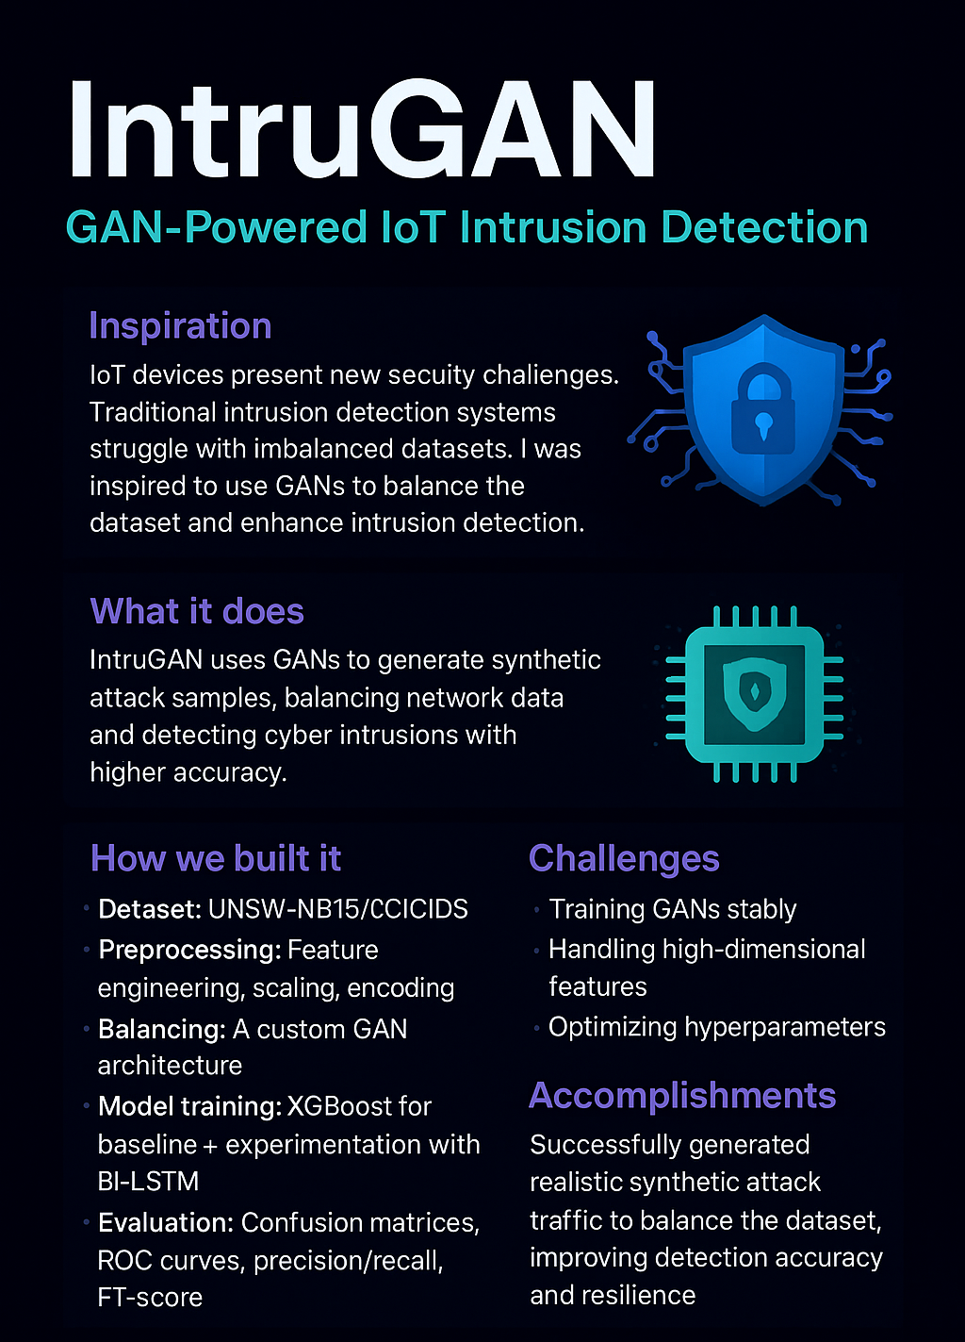

Slide 2
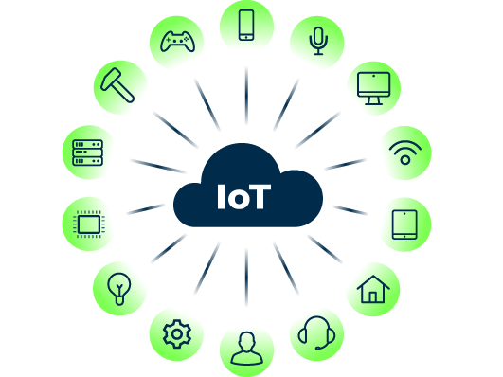
INTERNET OF THINGS (IoTs)
IoT connects billions of devices globally (sensors, machines, appliances)
Generates huge real-time network traffic
Important for smart cities, healthcare, industry
Securing this traffic is critical to prevent cyber threats
Notes:
Imagine your phone, your car, your fridge, and even your watch — all connected and communicating with each other. That’s what IoT is all about. It connects billions of smart devices across the world, making our homes, cities, and industries smarter and more efficient. In this presentation, I’ll explain how IoT works, why it’s important, and why securing it is a big challenge.”

Slide 3
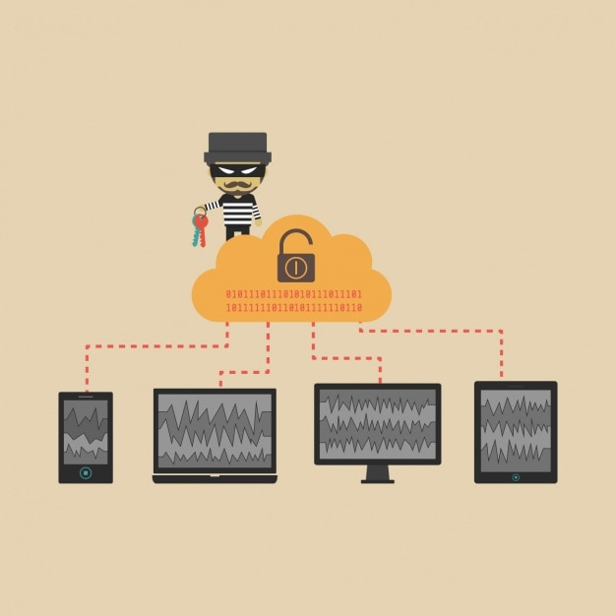
INTRUSION DETECTION SYSTEM(IDS)
Monitors network traffic
Detects suspicious or abnormal behavior
Alerts or blocks threats like: • Unauthorized access • Data breaches • DDoS (denial-of-service) attacks
Acts like a security guard for your IoT network
Notes:
Now that we’ve seen how IoT connects many devices, let’s talk about how we protect them. One key tool is the Intrusion Detection System, or IDS. Think of it like a smart security guard that watches the network and warns us if something suspicious happens.

Slide 4
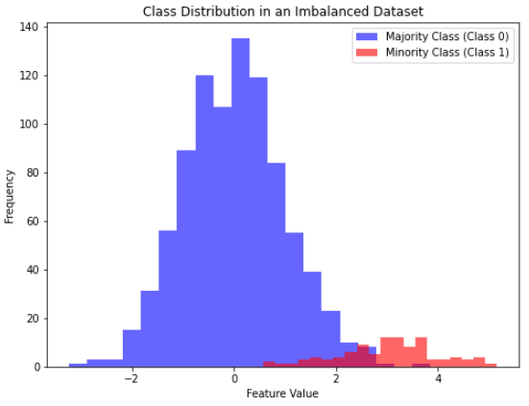
Problem of Imbalanced Data
IoT data is highly imbalanced
ML models become biased and miss threats
Oversampling causes overfitting
Undersampling removes useful data
Notes:
One big challenge in IoT security is that most of the data is normal, and only a little is dangerous. This imbalance confuses machine learning models, which can lead to missed threats or poor performance.
Oversampling means adding more copies of the minority class (rare attack data) so that the dataset becomes balanced.
Undersampling means removing some of the majority class (normal data) so that both classes have similar amounts.

Slide 5
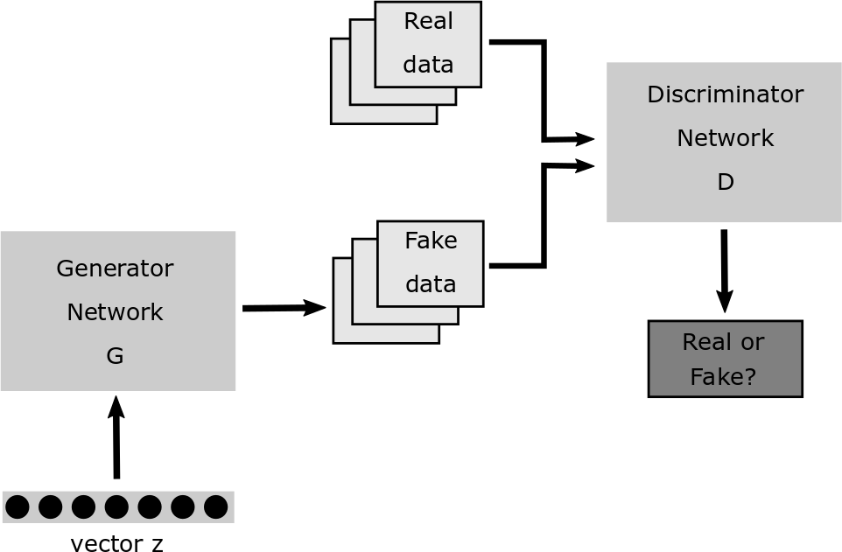
Baseline GAN
GAN = Generator + Discriminator
Generates realistic synthetic malicious samples
Balances dataset
Improves IDS accuracy and robustness
Notes:
In IoT security, we can use GANs to create fake malicious data that looks real. This helps balance the dataset and train the IDS better. As a result, the IDS becomes more accurate and more prepared to catch real attacks.
We found that the baseline GAN had major issues like lack of diversity, poor handling of rare attacks, and unstable training. To solve these, we proposed our own advanced model — ReMWGAN-FM — which uses multiple generators, reweighting, and feature matching to produce better and more balanced synthetic data.

Slide 6
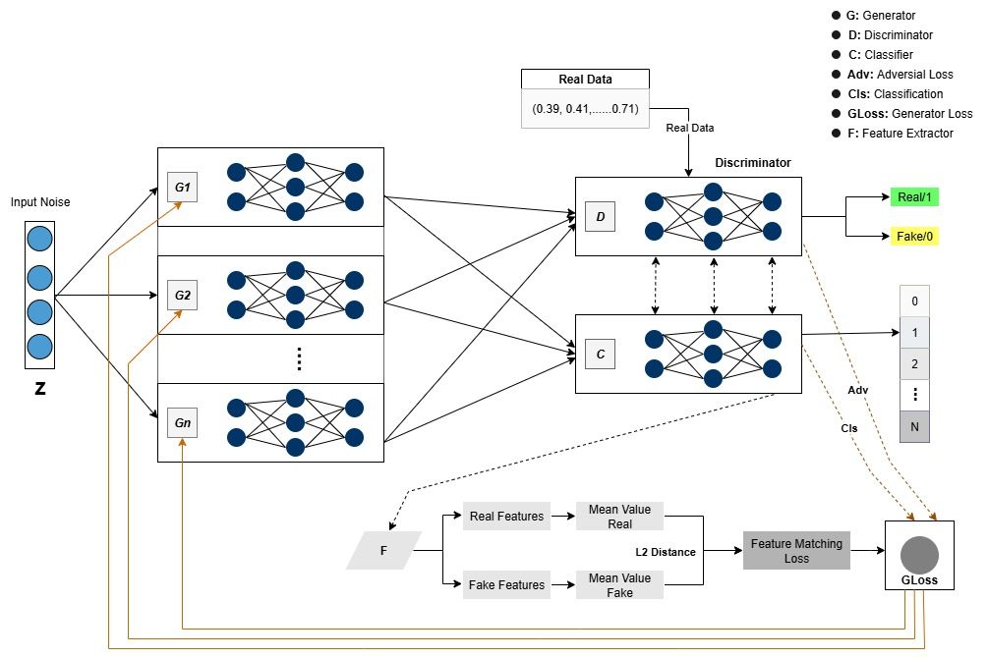
Proposed ReMWGAN-FM GAN
Notes:
We propose a new and improved GAN model called Reweighted Multi-Generator Wasserstein GAN with Feature Matching (ReMWGAN-FM). It uses multiple generators to create more diverse and realistic attack samples. It also gives more importance (reweighting) to rare attack types so the model doesn’t ignore them. The Wasserstein loss helps the training stay stable, and Feature Matching ensures the fake data looks more like the real data. Overall, this model improves the balance, quality, and usefulness of the training data for IDS.

Slide 7
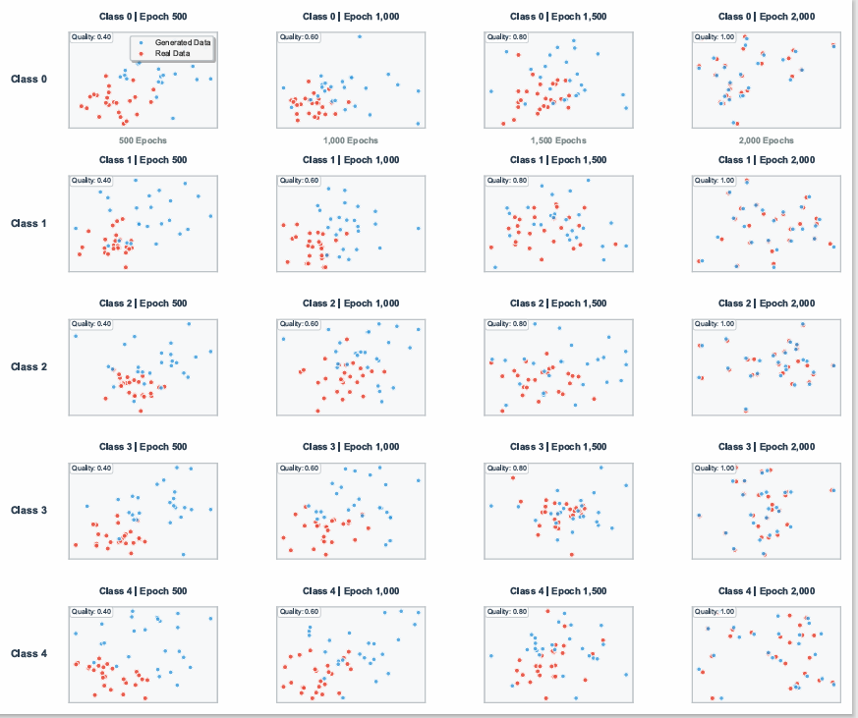
Class Evaluation Plot Graph

Slide 8
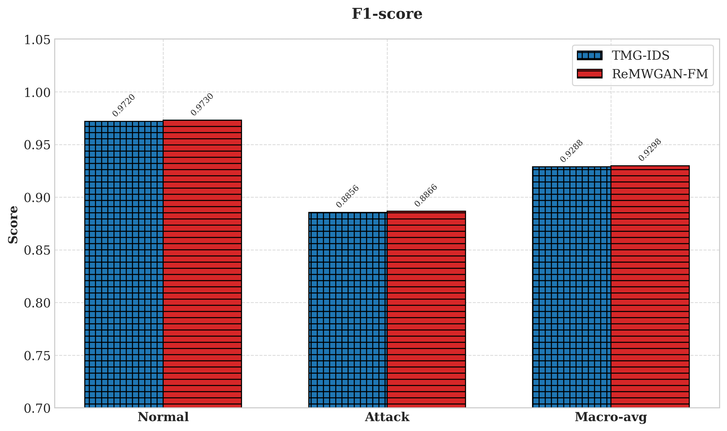
Binary Class F1 Score

Slide 9
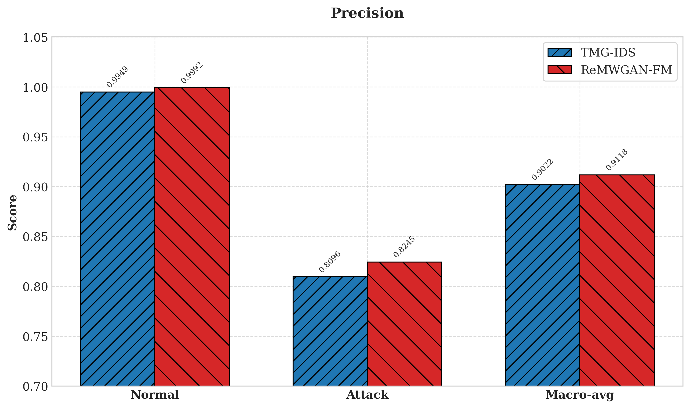
Binary Class Precision

Slide 10
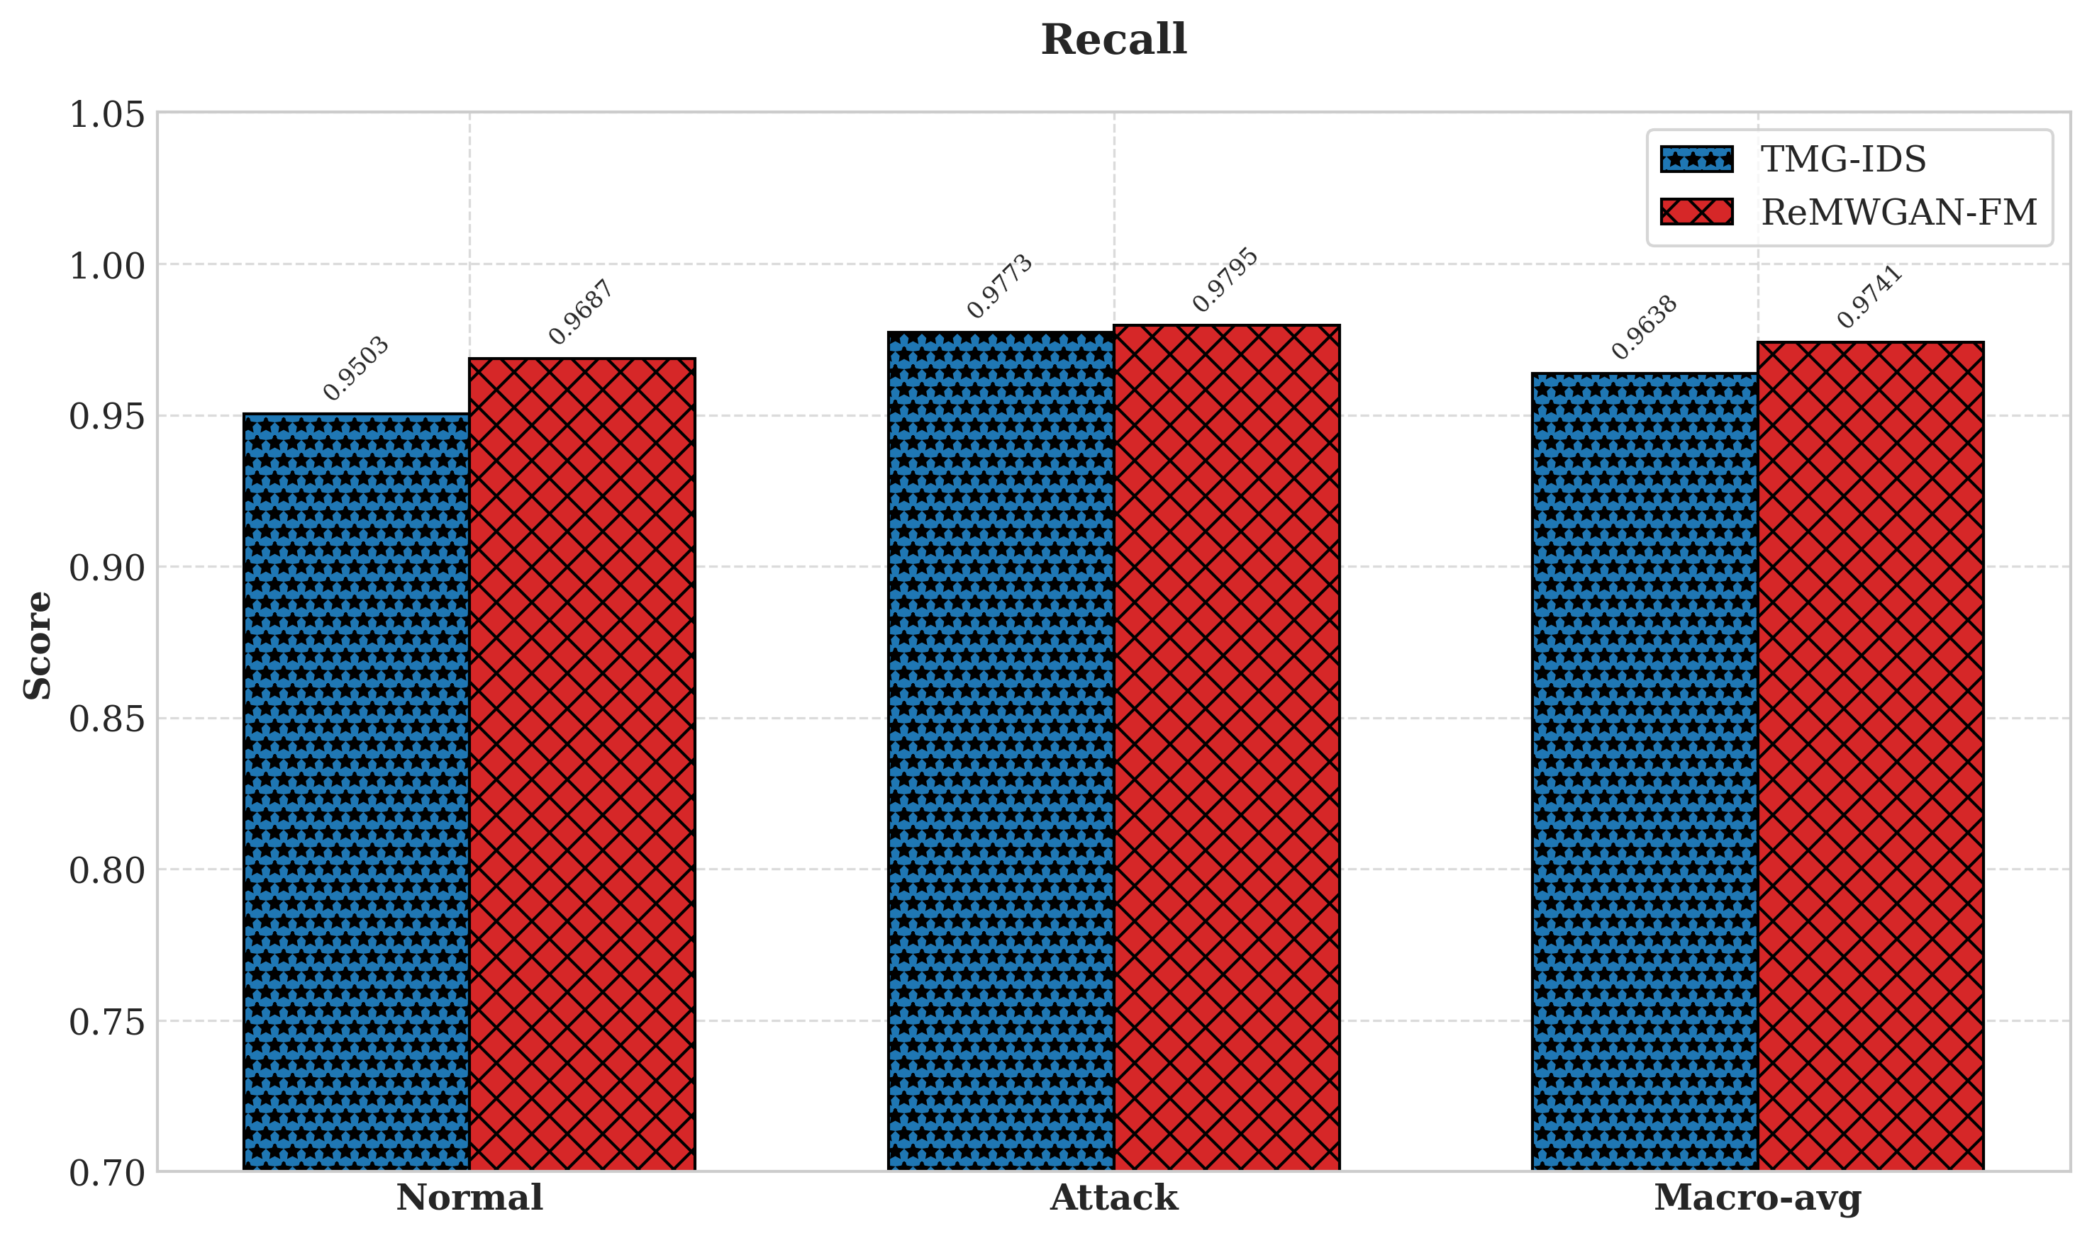
Binary Class Recall

Slide 11
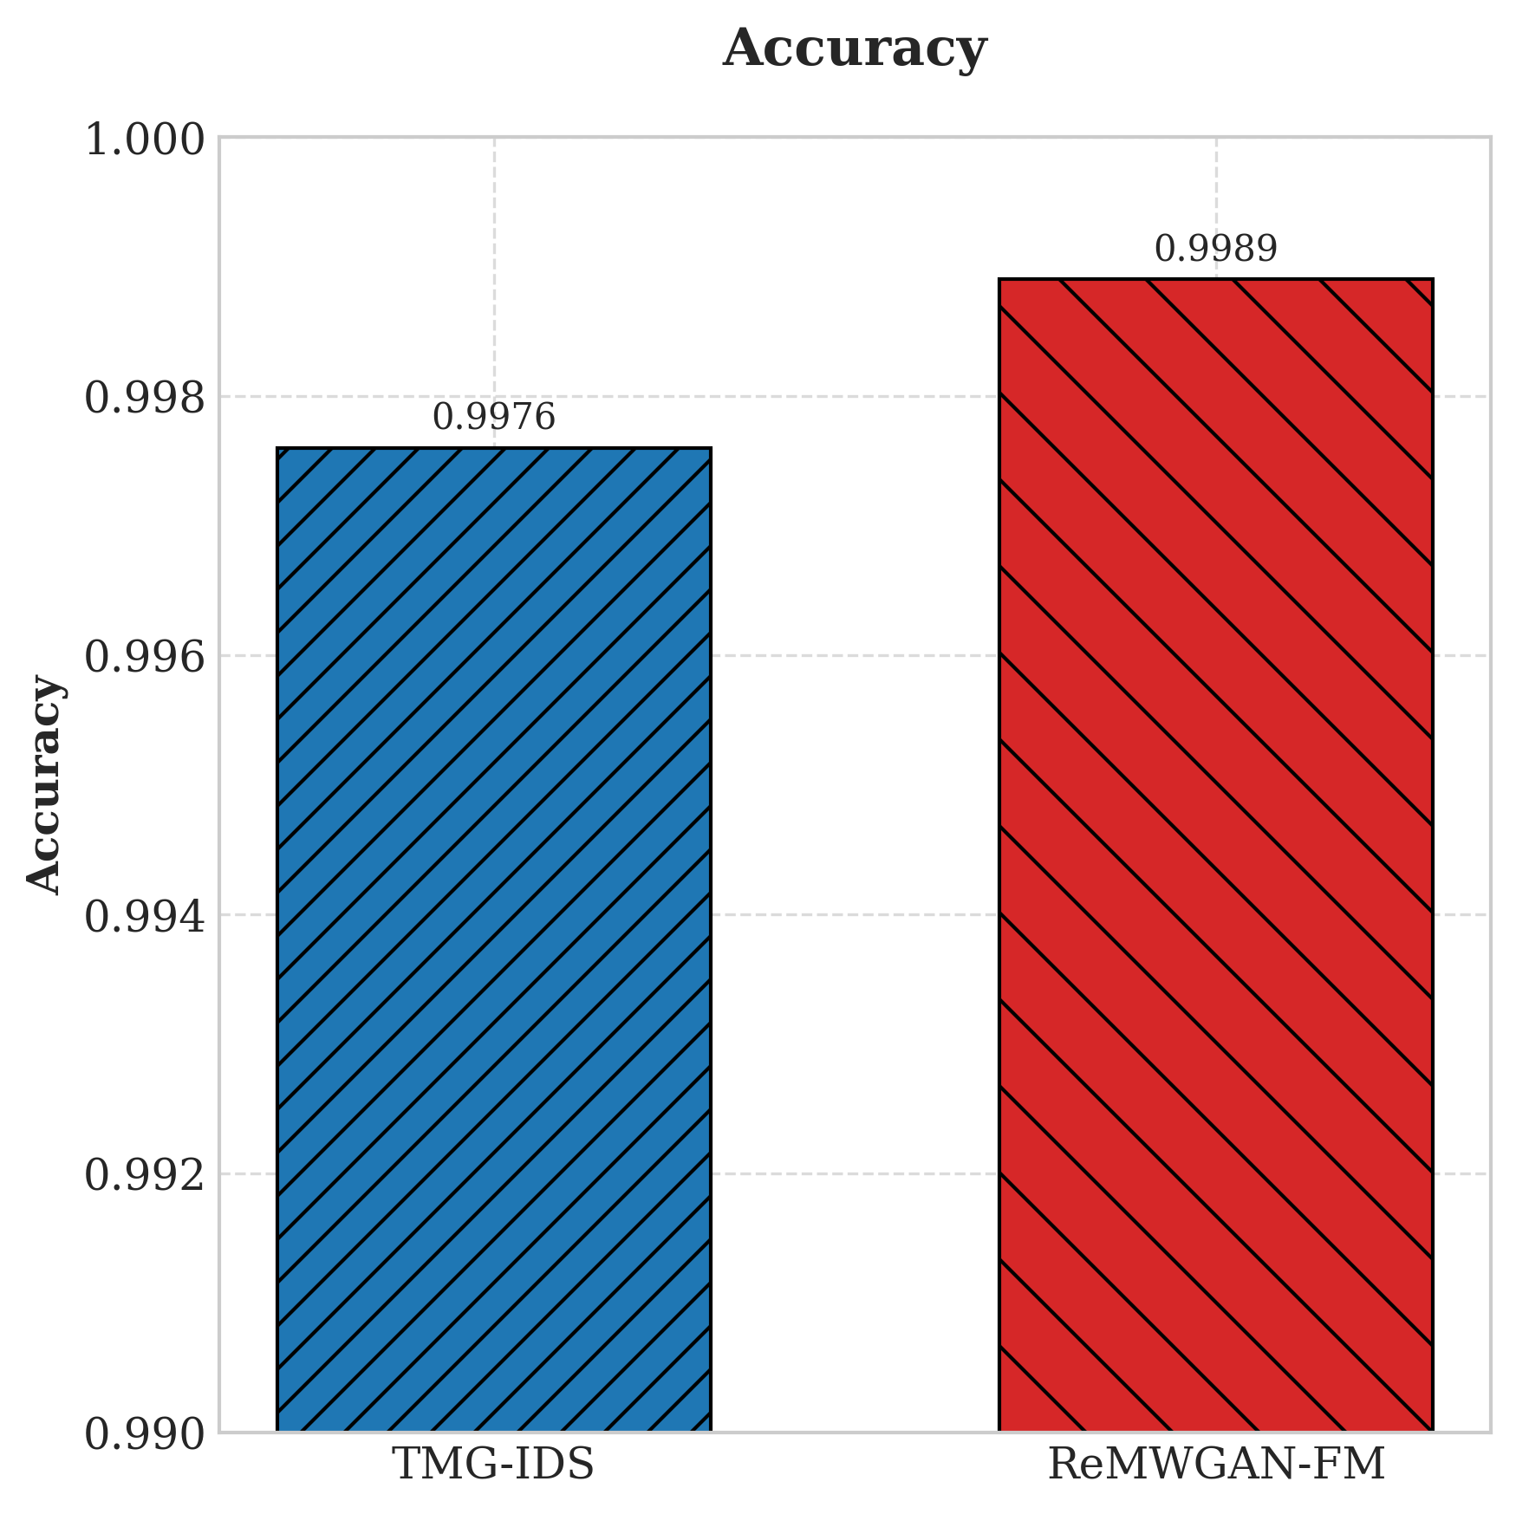
Binary Class Accuracy

Slide 12
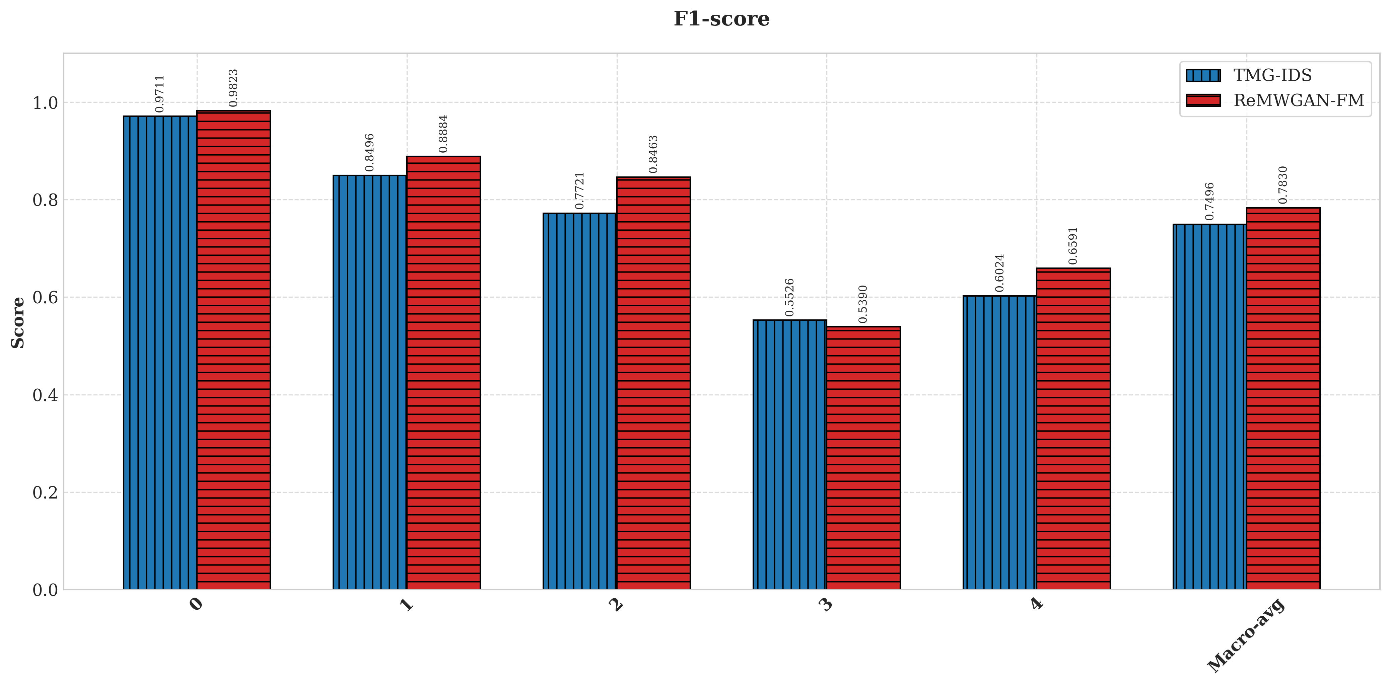
Multi Class F1 Score

Slide 13
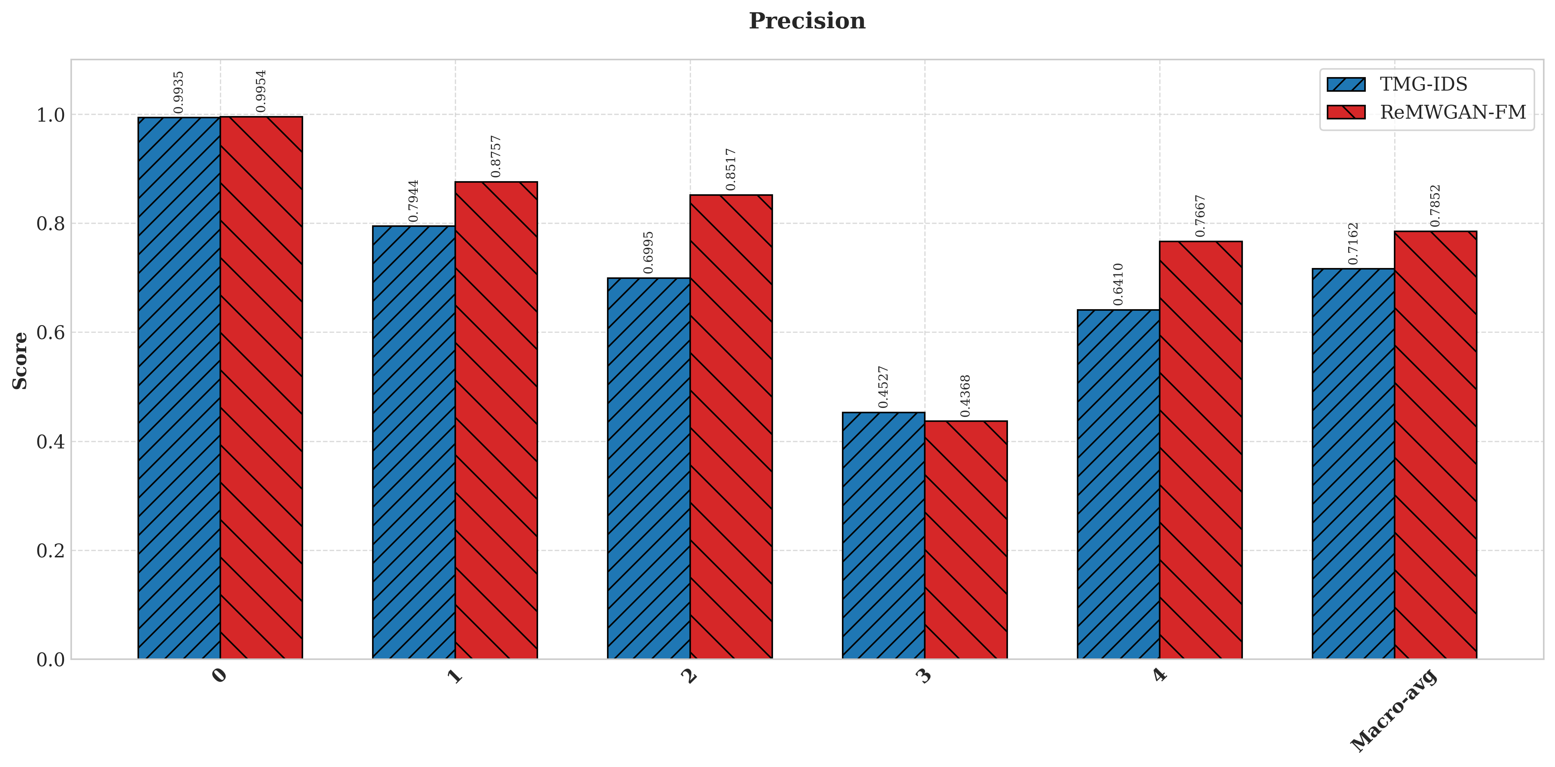
Multi Class Precision

Slide 14
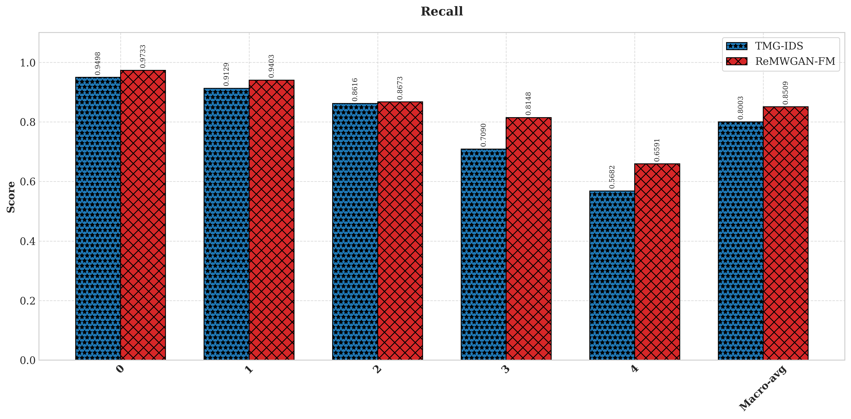
Multi Class Recall

Slide 15
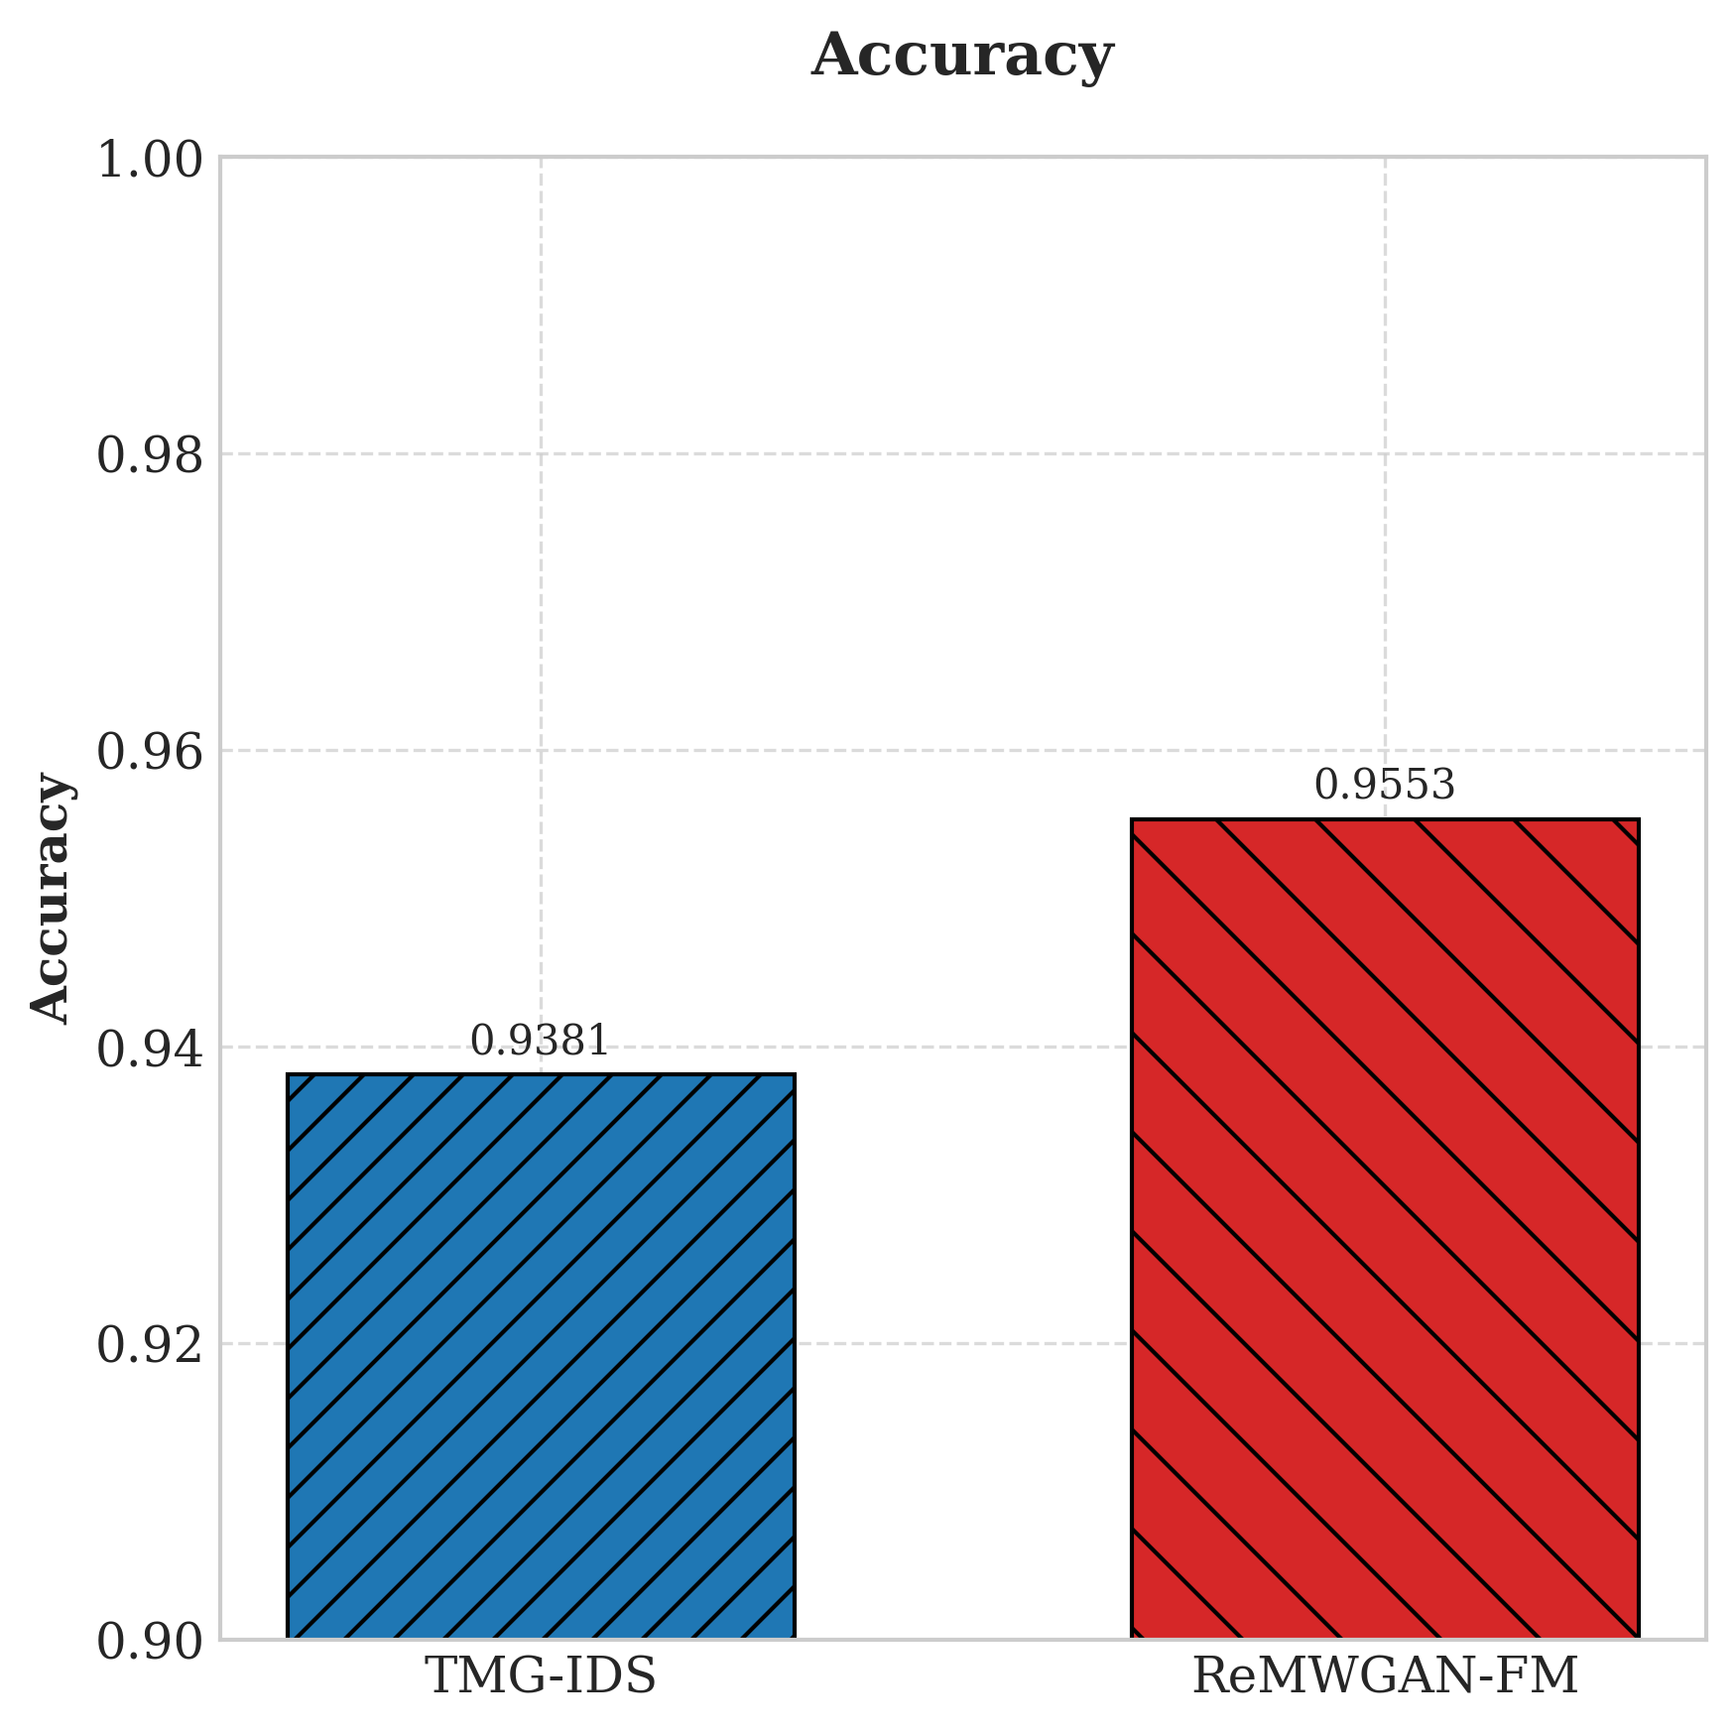
Multi Class Accuracy

Slide 16
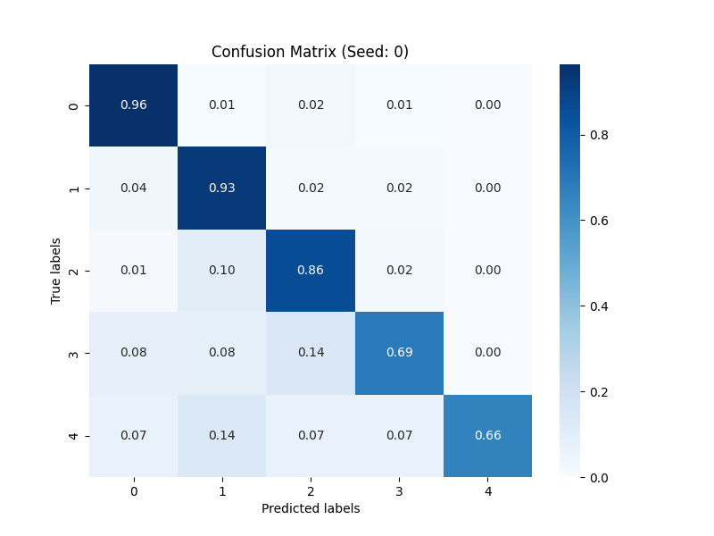
Multi Class Confusion Matrix

Slide 17
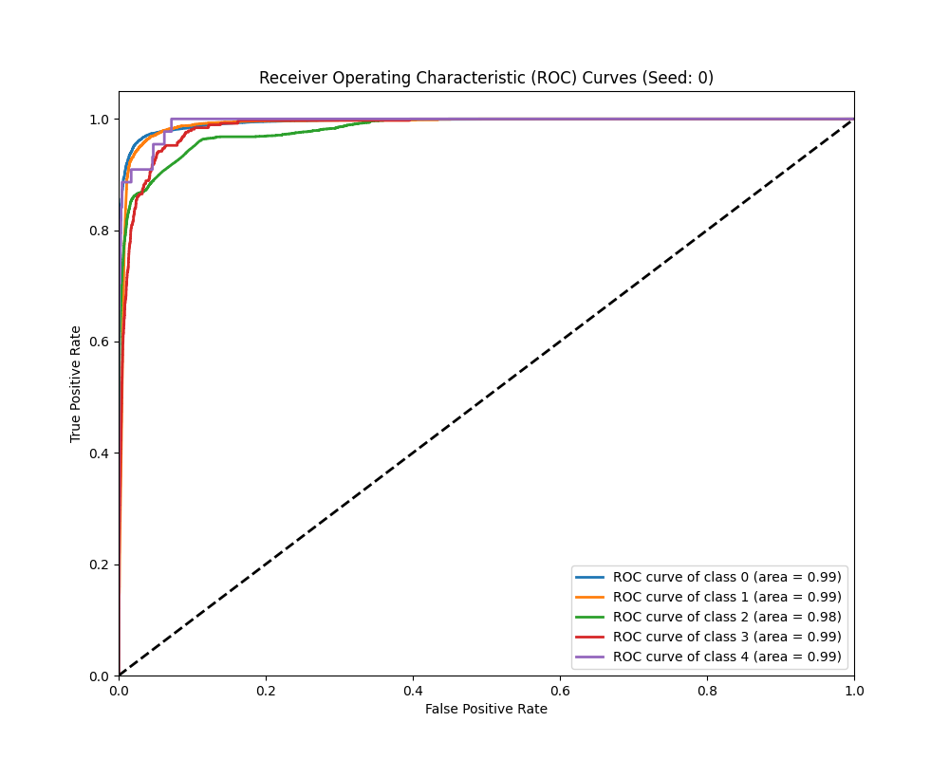
Multi Class ROC Curves

Slide 18
Scope
Identify unusual activities in IoT network traffic.
Use GANs to address data imbalance.
Clean and prepare network traffic data.
Display traffic patterns and detection outcomes.
An interactive full Web Application.

Slide 19
Fully Dressed Use Case(Main Use Case)
Login
Preprocessing
Data Visualization
Data Balancing
Intrusion Detection

Slide 20
THANK YOU

